Slide 1
An Introduction to Facebook Ads & Preparing Your 2022 Ads Strategy

Slide 2
Welcome!

Slide 3
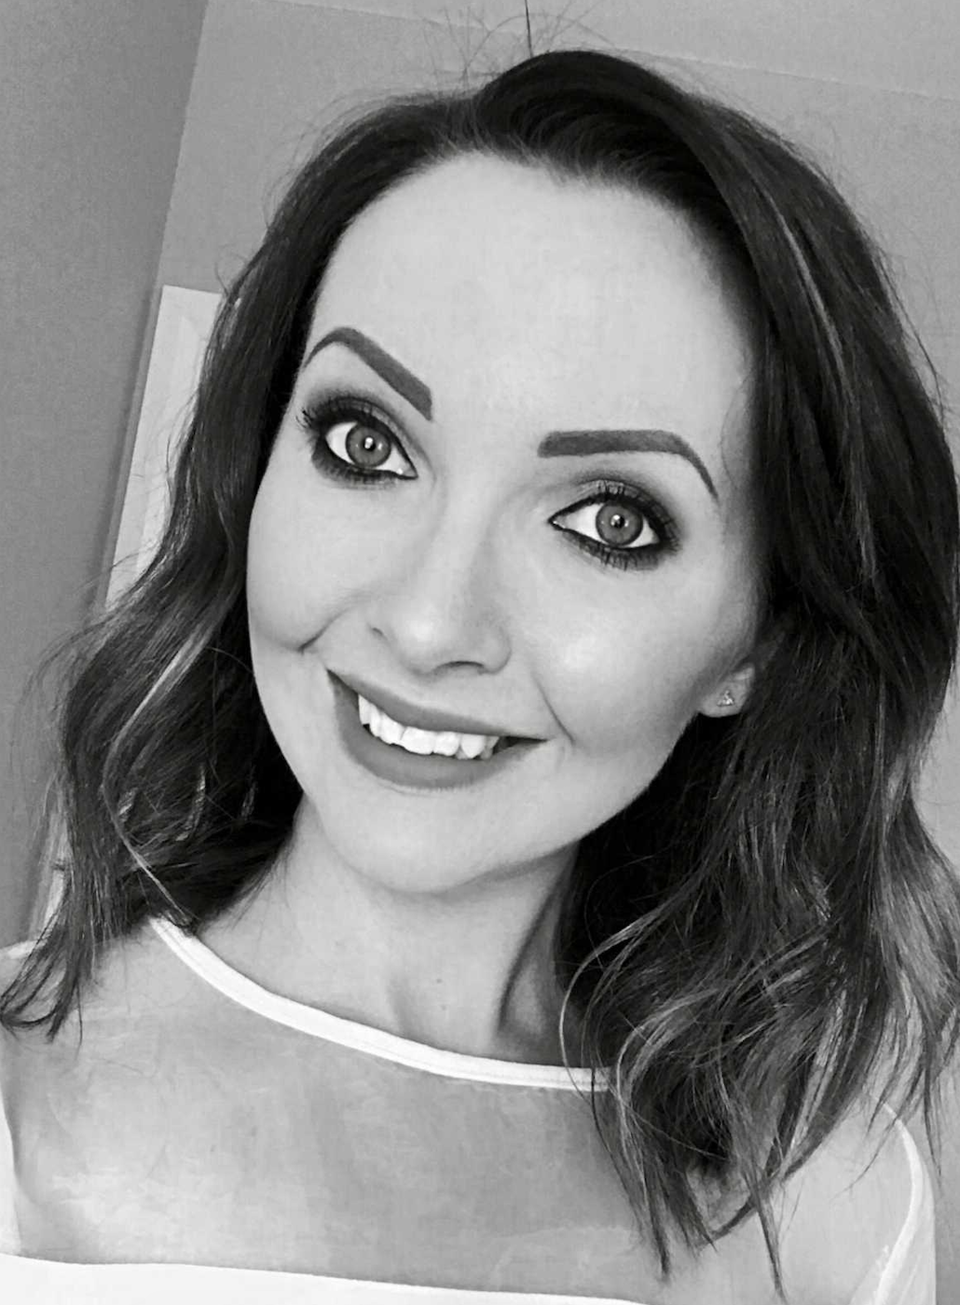
Caeris Armour
Digital Marketing Consultant
Facebook advertising enthusiast!

Slide 4
What will we cover?
What is Facebook Advertising?
Campaign Objectives
Audiences
The Importance of Creative
Facebook Ads Manager
The Facebook Pixel
iOS14 Update
Structuring a Campaign
Measuring and Monitoring
Live Demo – Freestyle
Developing Your 2022 Strategy
Key Takeaways

Slide 5
What is Facebook Advertising?

Slide 6
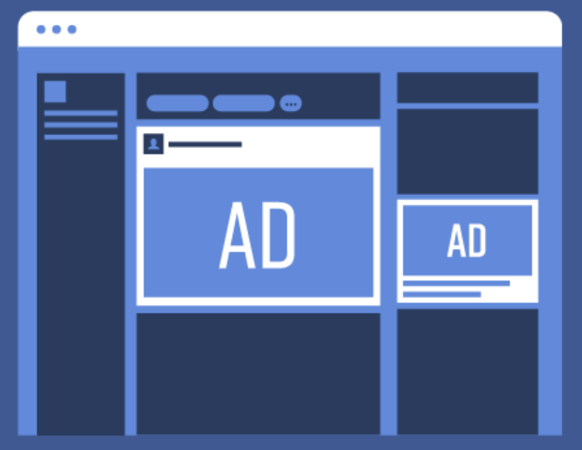
What is Facebook Advertising?
Facebook ads are paid messages from businesses that are displayed across Facebook’s network of platforms, targeting users who are important to that business. Advertisers create campaigns that have specific goals, referred to as campaign objectives, and create dedicated ads within those campaigns to help them reach their objective.

Slide 7
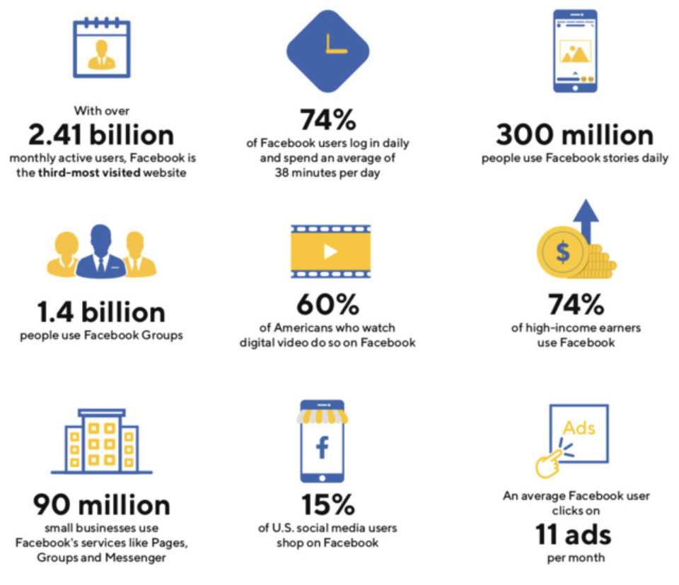
What is Facebook Advertising?
Why should I advertise on Facebook?
2 billion monthly active users
96% of all social media marketers consider Facebook advertising to be the most effective paid option of all social media networks
Complete control of your own budget
Extensive user data for hyper-relevant targeting
Trackable – you know what you get for your money
Reasonably user friendly to set up
Cross-platform reach

Slide 8
Campaign Objectives
What are you trying to do?

Slide 9
Campaign Objectives
It’s not just boosted posts!

Slide 10
Campaign Objectives
Brand awareness: Increase overall brand awareness by showing ads to people most likely to remember them
Reach: Show your ads to as many people as possible
Traffic: Send people to a destination, such as your website
Engagement: Get more post engagement, page likes or event responses
App installs: Get more users to install your app
Video views: Promote video views to raise awareness about your brand
Messages: Get more people to have conversations with your business via Messenger
Lead generation: Collect lead information directly within the Facebook platform
Conversions: Get people to take valuable actions on your website
Catalogue sales: Show users products from your range
Store visits: Encourage users to visit your physical premises

Slide 11
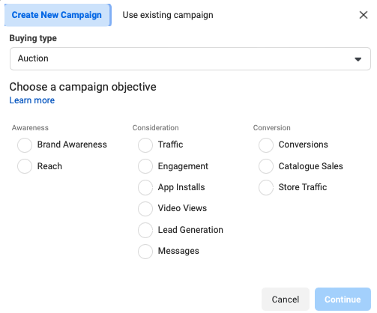
Campaign Objectives

Slide 12
Audiences
Who can I reach with Facebook Ads?

Slide 13
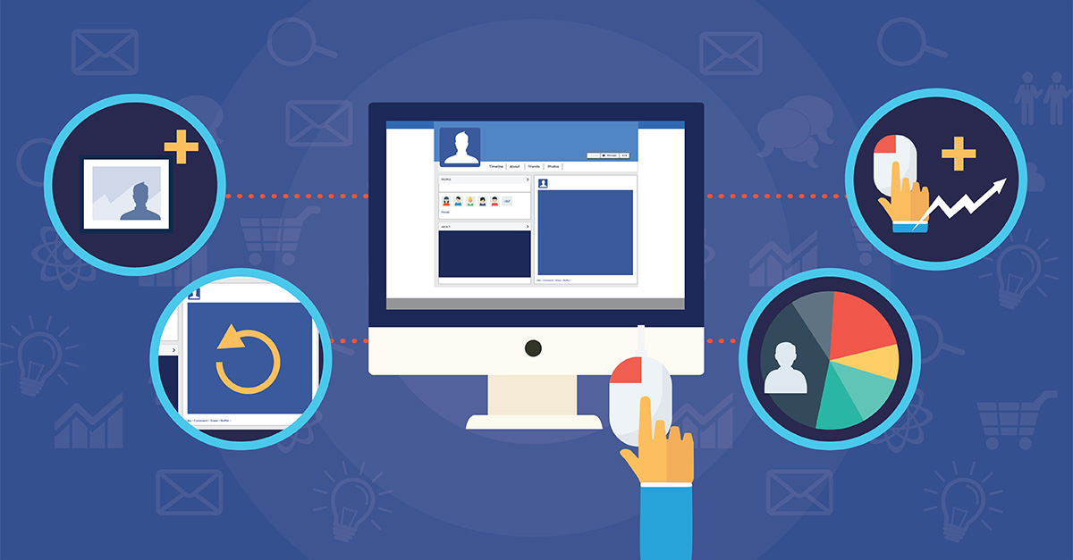
Audiences
Audiences
Saved audiences
Custom audiences
Lookalike audiences

Slide 14
Audiences
Top Tips
Don’t target multiple interests/behaviours at once
Narrow your audience with the AND/OR targeting options
Use exclusions to avoid wasted spend eg. exclude your existing email subscribers
Test, test, test

Slide 15
The Importance of Creative
How can I stand out?

Slide 16
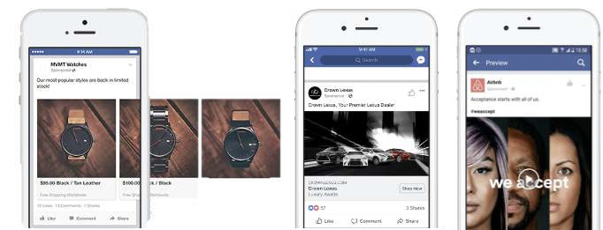
The Importance of Creative
Ad Formats
Single image
Carousel
Video

Slide 17
The Importance of Creative
Structuring an ad
Headline – This is the main title of your ad that should grab attention. Aim for 3-5 words max.
Primary text – A short, snappy description about what you are promoting highlighting key information and selling points. Make use of effective formatting and subtle emojis.
Description (optional) – A useful area to provide a brief synopsis of your business. Not visible in all placements.
Creative – An image, multiple images or video uniquely showcasing what you are promoting.
Call-to-action (CTA) button – Choose from phrases such as ‘Contact Us or ‘Learn More’

Slide 18
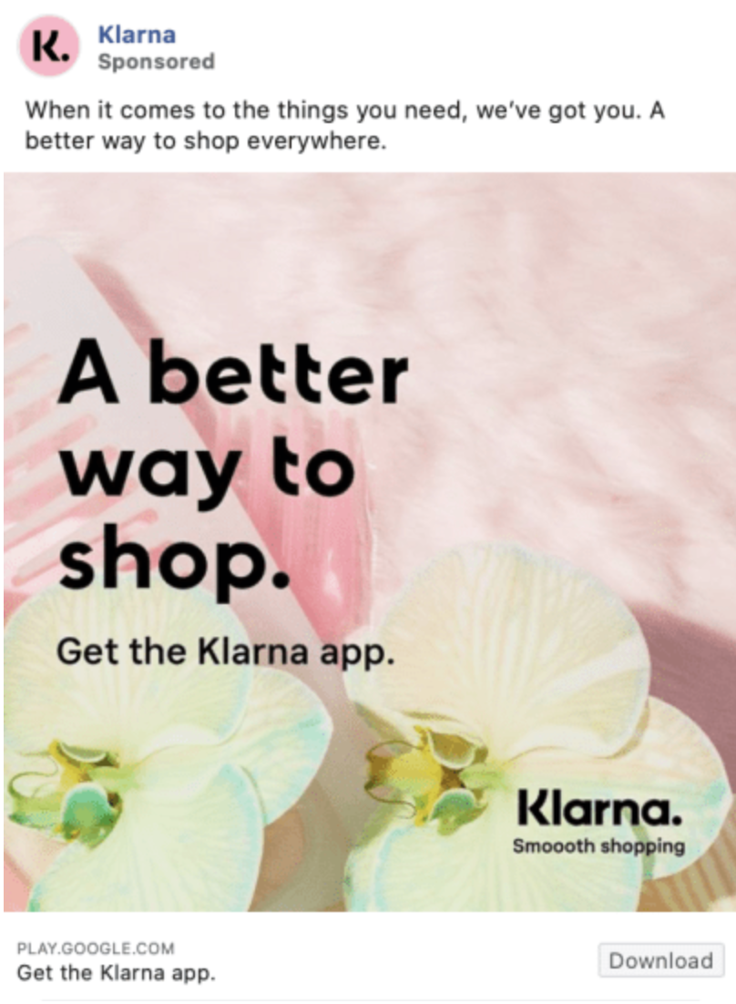
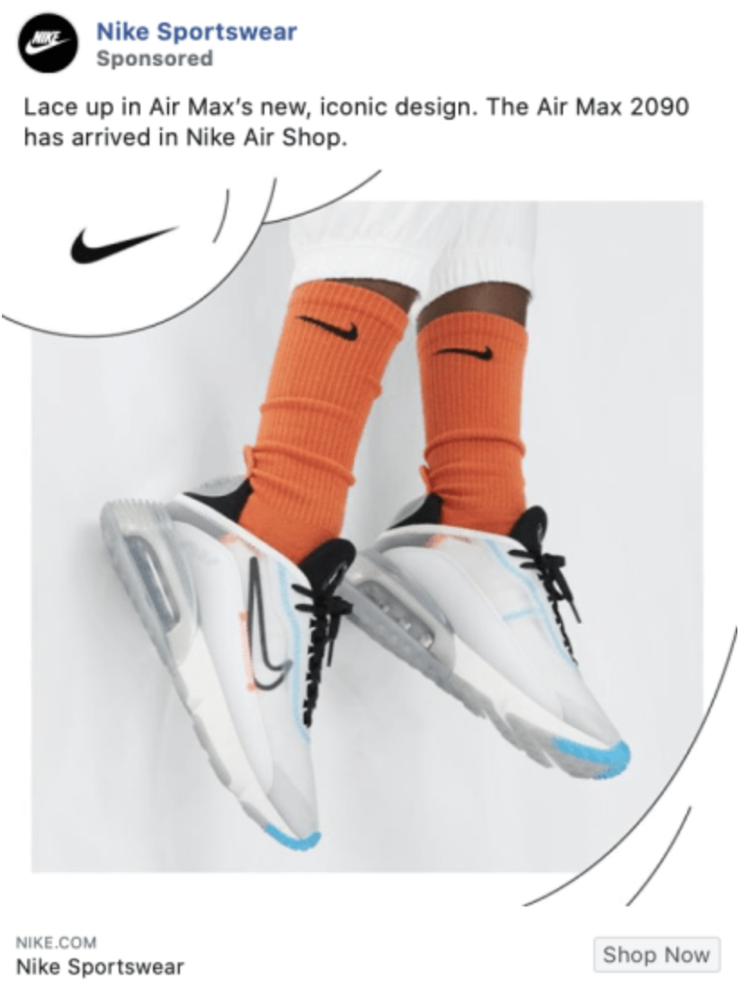
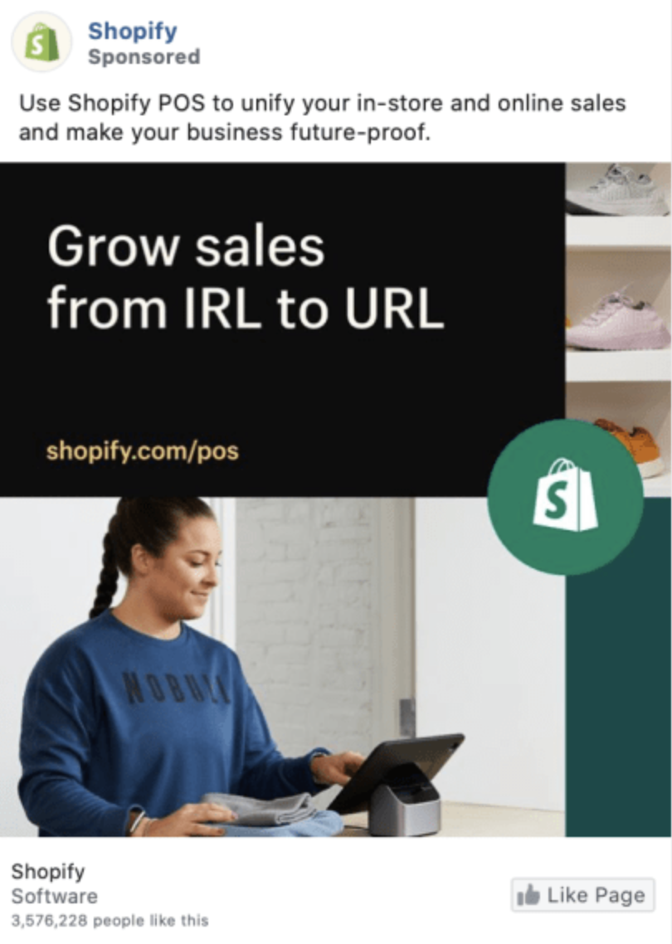
The Importance of Creative

Slide 19
The Importance of Creative
Top Tips
Original imagery is best – avoid using stock imagery if possible
Make it catchy and memorable
Size appropriately and crop for each placement
Keep it on-brand
Incentivise where possible
The < 20% text rule was recently removed…but stick to it regardless
Test, test, test

Slide 20
Facebook Ads Manager
How do I work this thing?

Slide 21
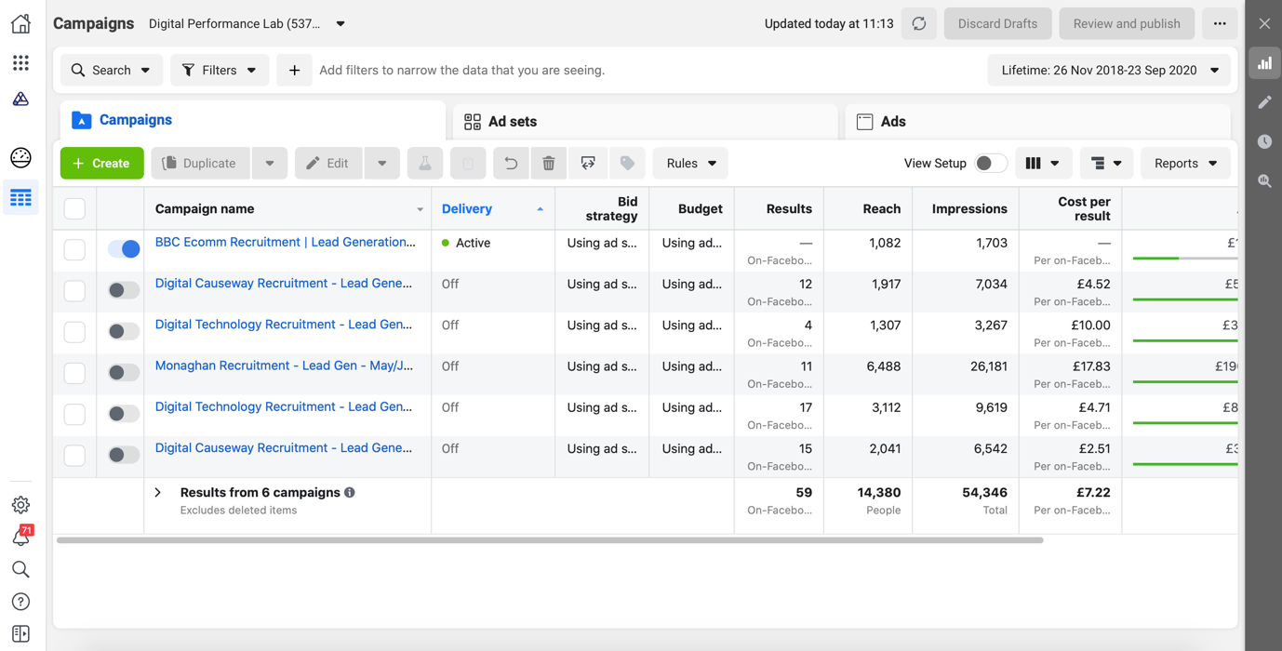
Facebook Ads Manager

Slide 22
Facebook Ads Manager
You can find Facebook Ads Manager by going to www.facebook.com/adsmanager/manage when logged into the Facebook account associated with your business page. Here you will see any previous campaigns you have run via your Facebook business page, even if you have never accessed your Ads Manager!
Alternatively you can locate Ads Manager from your Facebook business page by opening Ad Centre, going to All Ads, scrolling to the very bottom and selecting ‘Show more details in Ads Manager’.

Slide 23
The Facebook Pixel
What’s that?

Slide 24
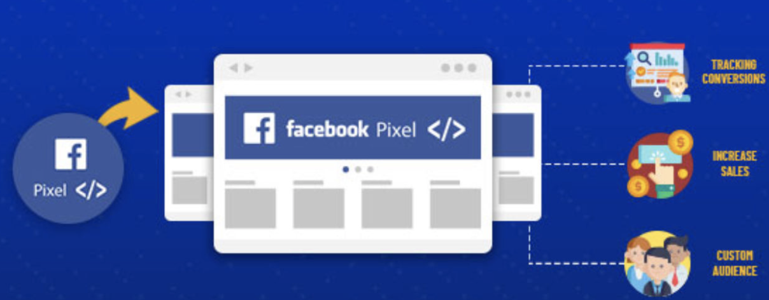
The Facebook Pixel
The Facebook Pixel is a small snippet of code that you place on your website which collects data and helps you track conversions from Facebook Ads, optimise ads, build targeted audiences for future ads and remarket to people who have already taken some kind of action on your website.

Slide 25
iOS14 Update
What’s that?

Slide 26
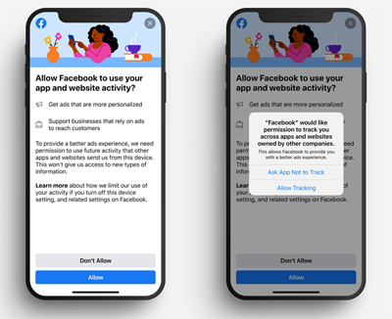
iOS14 Update
The iOS14 update was the fourteenth major update of the iOS mobile operating system developed by Apple which rolled out around April 2021. Along with other key features, a key component of this update was privacy enhancements.
To summarise, all apps (including Facebook) must now get user permission to track them across websites.

Slide 27
iOS14 Update
Therefore, any users who opt not to be tracked can no longer be tracked by the Facebook Pixel. This has resulted in the following;
Reduced audience sizes (especially remarketing lists)
Delayed reporting (conversions appearing days after campaigns have ended)
Less available data (such as when viewing breakdowns of user demographics)
Under-reporting (some activity simply won’t be tracked)

Slide 28
iOS14 Update
There are a few actions required as a result of this, to ensure your Facebook Ads can continue to perform as well as possible whilst respecting privacy preferences:
Verify your business domain (website) within Ads Manager to prove ownership
Set up the Conversions API to track as much as possible
Set up aggregated events to prioritise your most important website actions
Enable automatic advanced matching to use customer information to match up website visitors
Keep an eye on your Resource Centre for any further updates or requirements

Slide 29
Structuring a Campaign
What should it look like?

Slide 30
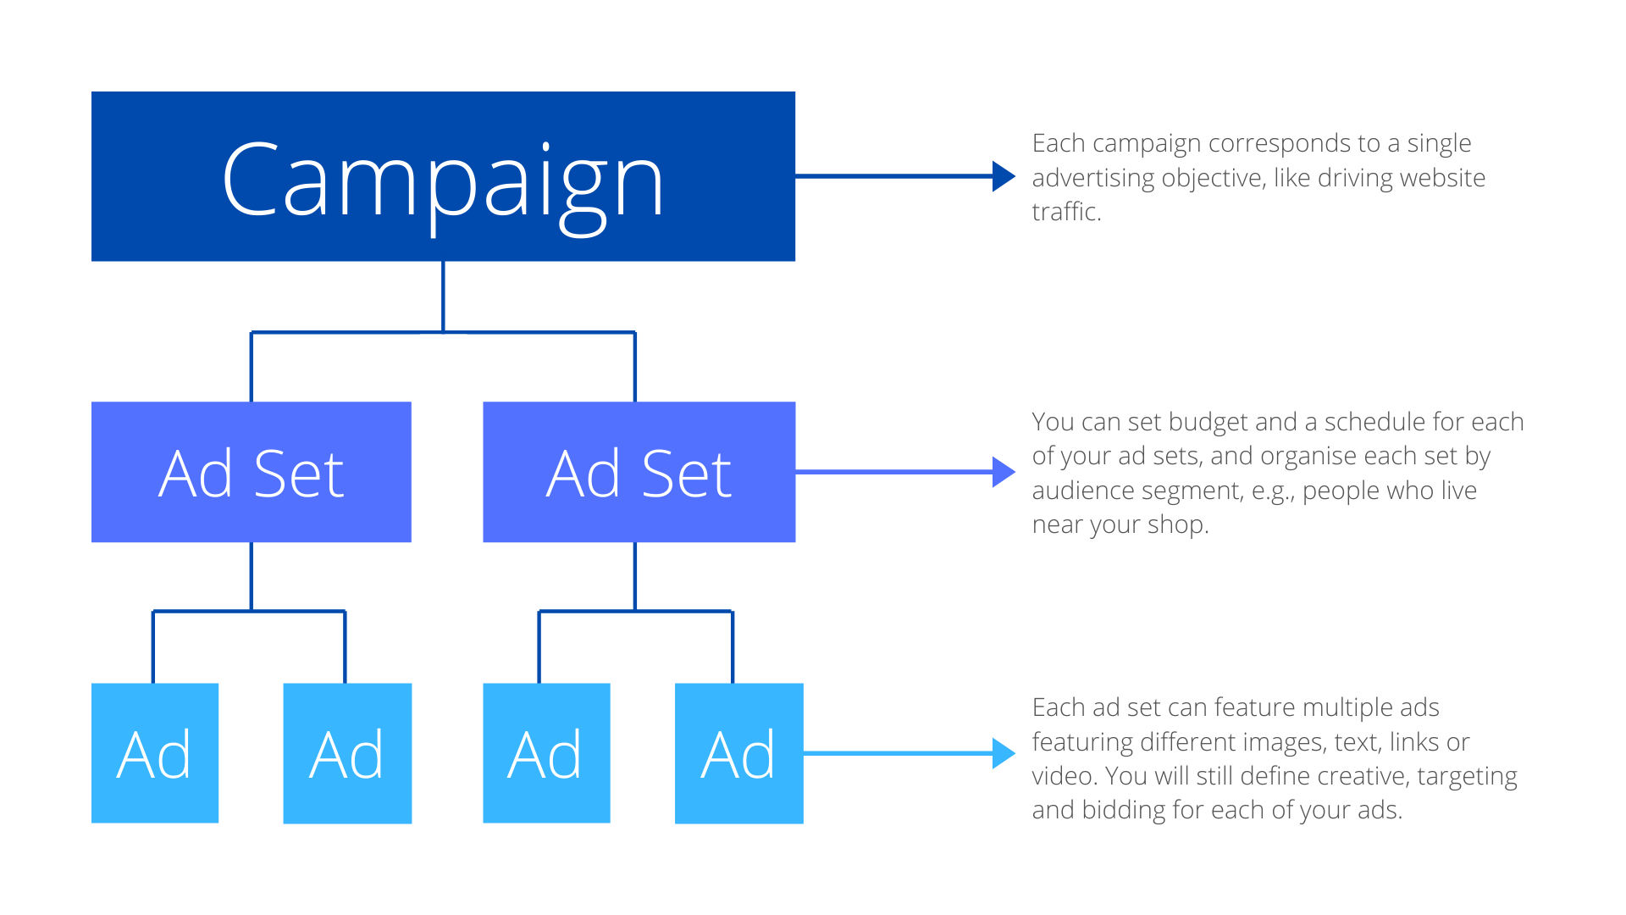
Structuring a Campaign
Each campaign should have;
A campaign objective based on your goal
2-3 ad sets testing various audiences
2-3 ads per ad set testing various creatives

Slide 31
Measurement
How do I know what works?

Slide 32
Measurement
The importance of measurement
Determine what metrics are important to you, relevant to your business goals
Don’t focus on vanity metrics – focus on the metrics that make you money!
Allocate time to analyse and report on campaign performance
Use the wealth of data available to you to learn and adjust
The beauty of digital – nowhere to hide!

Slide 33
Measurement
Metrics to measure
Reach/impressions
Link clicks
Engagement
Video plays
Purchases
Purchase value / ROAS
Leads
Messenger conversations
Frequency
Standard events

Slide 34
Live Demo
Let’s give it a go!

Slide 35
Developing Your 2022 Ads Strategy
Where do I start?

Slide 36
Developing Your 2022 Ads Strategy
Get set up: Ensure you have a dedicated Ads Manager account for your business; your have implemented relevant iOS14 measures; your pixel is on your website; and you have various audiences set up to test.
Budget: Select a monthly budget you are comfortable spending to begin with. The frequency of your ads will be determined by this.
Objectives: What do you want the ads to do – Get more page likes? Generate new email subscribers? Sell? List your goals. You should alternative between awareness/sales goals with your campaigns.
Timing: Use tools such as Days of the Year and Google Trends to time your campaigns for success. Map this out in writing.
Collate assets: Get yourself a strong bank of photos/images to utilise within your campaigns.

Slide 37
Developing Your 2022 Ads Strategy
6. Build: Set time aside to build your campaigns. If you are new to the platform we recommend setting up a few campaigns whilst this is fresh in your head – you can always pause for future use.
7. Analyse, learn, adjust: Utilise the metrics available to you to see what works. Don’t be rigid with your plan – adjust as you go based on this learning. This may mean changing planned campaign objectives, making more videos etc.
8. Think 2023: Keep note of what did or didn’t work this year. Did a Summer Sale launched in August work particularly well? Try to replicate that next year!

Slide 38
Developing Your 2022 Ads Strategy
Dates for your diary
January sales
Valentine’s Day
Mother’s Day
Easter
Father’s Day
Back to school
Halloween
Black Friday
Cyber Monday
Pre-Christmas
Boxing Day sales
Internal sales periods

Slide 39
Key Takeaways
Conclusion

Slide 40
Key Takeaways
Top tips
Build your audiences in advance
Data is your friend – listen to it
Get your website right
Creative is key
Install the FB Pixel
Never stop testing
Start small, grow gradually
Allocate time for analysis
Don’t change campaigns once live
Listen, learn, adjust

Slide 41
Final Q&A
Any questions?

Slide 42
Thank you
Any Questions?

