Slide 1



Social Media: An Introduction & What’s New in 2022

Slide 2
Welcome!

Slide 3

Evie Gates
Digital Marketing Consultant
Social media enthusiast!

Slide 4
What will we cover?
1. What is Social Media Marketing?
2. Best Practice and Key Features:
Facebook
Instagram
Twitter
LinkedIn
3. Developing a Social Content Strategy
4. Key Tools for Social Media
5. Future Opportunities
6. Key Takeaways
7. Final Q&A

Slide 5
What is
Social Media Marketing?

Slide 6

What is Social Media Marketing?
Social media marketing is the use of social media platforms to connect with your audience to build your brand, increase sales, and drive website traffic.
This involves publishing great content on your social media profiles, listening to and engaging your followers and analysing your results to constantly improve.

Slide 7
What is Social Media Marketing?
The major social media platforms (at the moment) are:
Facebook (2+ billion users)
Instagram (1 billion users)
Twitter (396.5 million users)
LinkedIn (690 million users)
TikTok (1 billion users)
Pinterest (442 million users)
YouTube (2.3 billion users)
Snapchat (293 million users)

Slide 8
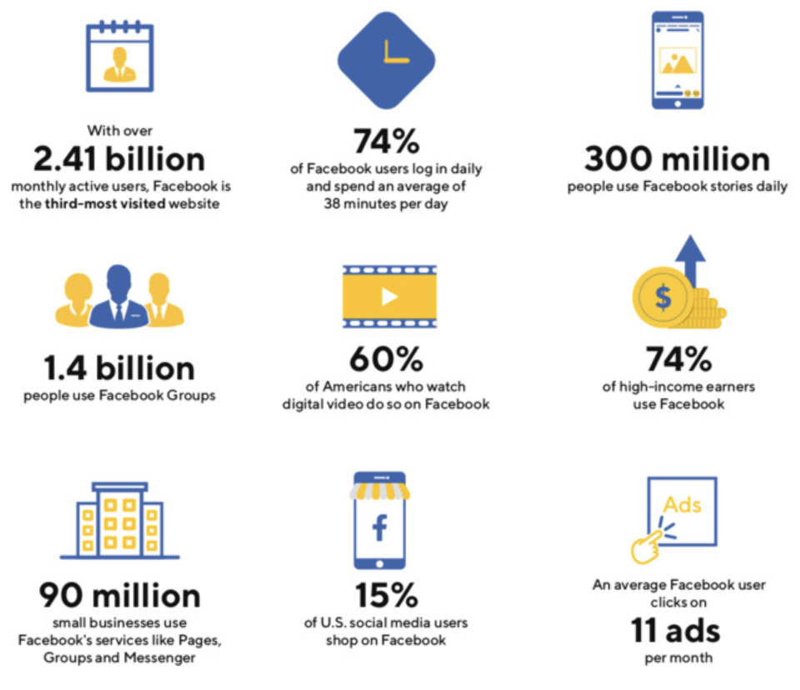
What is Social Media Marketing?
Why Should Invest Time in Social Media?
If you’re a small business, social media offers a great opportunity to really make the most of your marketing activity. Here’s why:
It’s where your customers are
It’s efficient for your business
It helps you stand out from the crowd
It builds your business community
It allows you to be creative

Slide 9
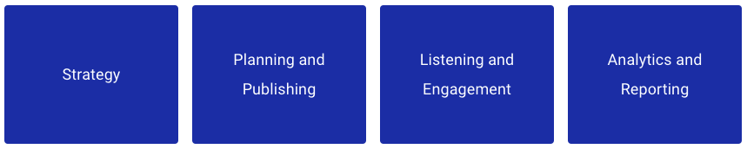
What is Social Media Marketing?
The 4 Core Pillars of Social Media Marketing

Slide 10
What is Social Media Marketing?
The 4 Core Pillars of Social Media Marketing - Strategy
What are your goals? How can social media help you achieve your business goals? Some businesses use social media for increasing their brand awareness, others use it for driving website traffic and sales.
Social media can also help you generate engagement around your brand, create a community, and serve as a customer support channel for your customers.
Which social media platforms do you want to focus on? When starting out, it’s better to pick a few platforms that you think your target audience is on than to be on all platforms.
What type of content do you want to share? What type of content will attract your target audience best? Is it images, videos, or links? Is it educational or entertaining content? We’re going to get more in-depth with how you can build a social media strategy later.

Slide 11
What is Social Media Marketing?
The 4 Core Pillars of Social Media Marketing – Planning & Publishing
Social media marketing for small businesses usually starts with having a consistent presence on social media.
Publishing to social media is as simple as sharing a blog post, an image, or a video on a social media platform – but you will want to plan your content ahead of time instead of creating and publishing content spontaneously.
There are now a variety of social media scheduling tools, such as Creator Studio, that can help you publish your content automatically at your preferred time. This saves you time and allows you to reach your audience when they are most likely to engage with your content.

Slide 12
What is Social Media Marketing?
The 4 Core Pillars of Social Media Marketing – Listening & Engaging
As your business and social media following grow, conversations about your brand will also increase. People will comment on your social media posts, tag you in their social media posts, or message you directly.
People might even talk about your brand on social media without letting you know. So you will want to monitor social media conversations about your brand. If it’s a positive comment, you get a chance to surprise and delight them. Otherwise, you can offer support and correct a situation before it gets worse.
Be sure to check all your notifications across your social media platforms and don’t just read but respond to your followers!

Slide 13
What is Social Media Marketing?
The 4 Core Pillars of Social Media Marketing – Analytics & Reporting
Along the way, whether you are publishing content or engaging on social media, you will want to know how your social media marketing is performing.
Are you reaching more people on social media than last month?
How many positive mentions do you get a month?
How many people used your brand’s hashtag on their social media posts?
Each social media platforms provide insights into your followers and content – use them!

Slide 14
Best Practice & Key Features
Make the best of social

Slide 15

Facebook Best Practices & Key Features
Properly size your images
Pin your posts
Master timing for YOUR audience
Test & learn what works for your audience
Make it actionable – give them something to do!
Focus on connecting, not just selling
Try Facebook Live
Set up a Facebook Shop

Slide 16

Instagram Best Practices & Key Features
Maintain a consistent feed of high-quality visuals
Pay attention to what your audience wants and post for demand
Create Shoppable Posts
Perfect your timing
Tell visual stories
Use hashtags to boost content discovery
Make the most of games, contests & challenges
Correctly post URLs and Links
Think about Posts vs Stories
Make use of User Generated Content
Create Reels, Reels and more Reels!

Slide 17

Twitter Best Practices & Key Features
Revamp your Twitter profile
Engage and interact
Post your media directly on Twitter, don’t link out
Be relatable, not salesy
Don’t copy & paste content from your other channels!
Get involved with trends
Reduce your response times
Try some of Twitter’s new features: Fleets, Space, Tip Jar
Look into your competitors

Slide 18

LinkedIn Best Practices & Key Features
Use a LinkedIn Company Page for your content, then share on personal profiles
Create quality content
Try building Showcase Pages
Don’t use stock photos
Include CTAs
Use info from other people’s articles and industry news every once in a while
Stay consistent
Plan and follow a schedule

Slide 19
Developing a Social Content Strategy
Your plan of action

Slide 20

Developing a Social Content Strategy
Establish Your Goals
These could include:
Generating leads and sales
Increasing traffic to your website or a specific section of your website
Growing your brand audience
Increasing followers
Improving social media engagement

Slide 21
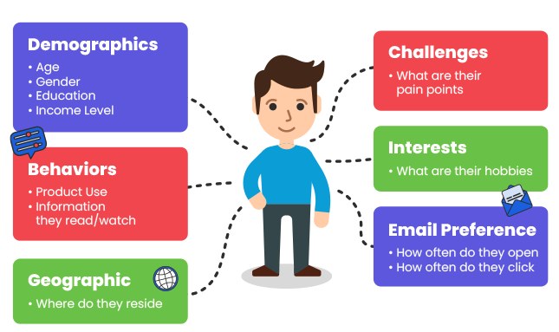
Developing a Social Content Strategy
Define Your Target Audience
The key points you should know about your audience are:
Age
Location
Job title or industry
Interests

Slide 22
Developing a Social Content Strategy
Choose Your Platforms
Once you’ve defined your audience, you’ll get better insight into which platforms you’ll be most likely to reach them on.
This is particularly important: whilst your audience may be on Facebook, if you are selling a B2B service, consider whether people are likely to convert on work related content on their personal platforms, outside of work hours. Is LinkedIn a better platform?
This will also enable you to start mapping out your strategy for each platform.

Slide 23
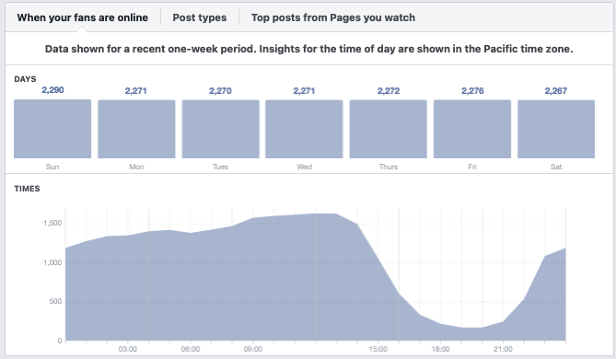
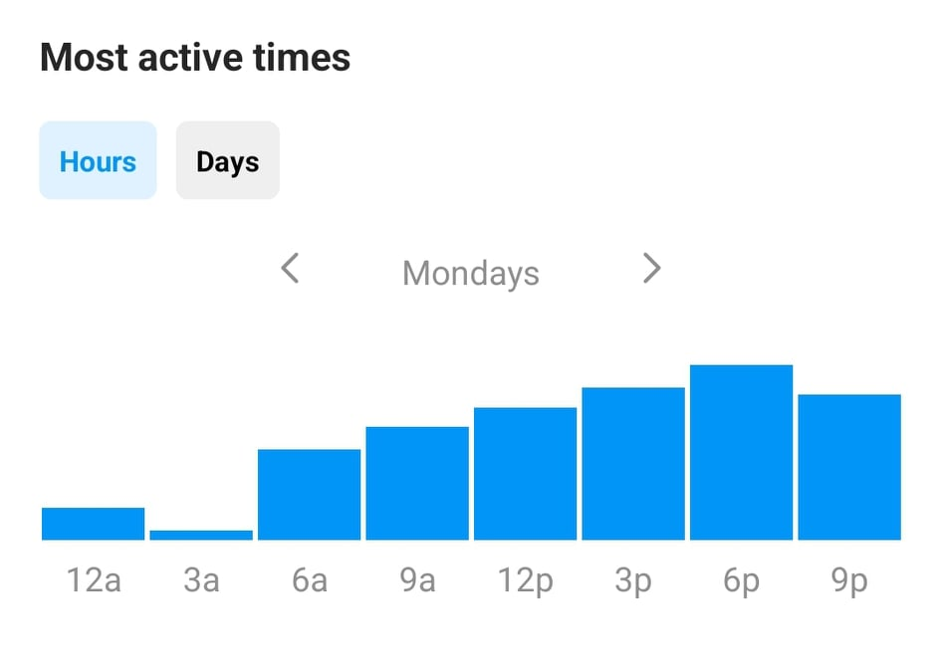
Developing a Social Content Strategy
Plan Your Posting Times
Check your insights on each platform and determine when you’re followers are most active. Make a list of these times for each social channel you will be using.

Slide 24
Developing a Social Content Strategy
Research Your Competitors
Get a head start and delve in to what your competitors are doing on social media. Chances are they’re already on there, so have a good look and take tips and ideas from what they’re doing.
Things to take note of:
What content do they share?
How often do they post?
What times or days do they post?
How often do they engage with others?
What industry hashtags do they use?

Slide 25
Developing a Social Content Strategy
Generate Content Ideas
This is the stage you can actually start to think about what you’re going to post.
Considering your target customers and key messages you can create content pillars. When planning content, you can choose to focus on one content pillar for each post – this ensures you’re covering a good range of content and not just posting products or selling services all the time.
Content Pillar |  | Purpose
1 | Who We Are | Focus on showcasing the business and what you do. You can also focus on who is behind the business, their expertise, their experience, their place in the team and their work. Showcase behind the scenes!
2 | Our Knowledge and Industry | Focus on showcasing the knowledge and expertise in the industry. This content pillar allows you to set yourself apart as a leader in the industry.
3 | Products / Services | Focus on the highlighting the products / services offered. These are the posts where you can sell, sell, sell.

Slide 26
Developing a Social Content Strategy
Draw Up a Content Calendar
MARCH – WEEK 1
Publish Date & Time | Target Audience | Content Pillar | Platform(s) | Content Idea / Post Copy | Accompanying Media

Slide 27
Key Tools for Social Media
How to make social easier!

Slide 28

Key Tools for Social Media
Canva
Creator Studio
Hootsuite
Answer the Public
Days of the Year
Best Hashtags
Later
Unsplash
Short URL
Videohive

Slide 29
Future Opportunities
What’s coming in 2022 and beyond?

Slide 30

Future Opportunities
Things to think about…
Get a head start if you’re not doing these things already, look into them…
Utilise Influencers
Create Shoppable Posts
The Rise of Groups
Get on TikTok
Checkout Chatbots & AI
Augmented Reality

Slide 31
Key Takeaways
To summarise…

Slide 32
Key Takeaways
Top tips
Social Media is important, invest time in it
Think about Strategy, Planning, Engagement and Analysing Results.
Follow best practices for your chosen platforms
Develop a great content strategy & stay organised!
Define your audience, create content that is useful to them.
Use a content calendar and schedule ahead of time
Make the best of social media tools!
Think about the future and stay ahead of social trends

Slide 33
Final Q&A
Any questions?

Slide 34
Thank you
See you next week!

